Slide 1
Business Profile System

Slide 2
Functional Requirements
As a user, I should be able to create my business profile from any of the subscribed product website.
As a user, I should be able to update my business profile from any of the subscribed product website.
As a system, I should validate the user update requests with all subscribed products and only update when all the requests have been validated.

Slide 3
Non-Functional Requirements
Scalability: The system should be scalable horizontally. New instances of Web Servers can be added behind the Load Balancer. Kafka, Redis, and DynamoDB offer scalable solutions by default.
Availability: By using the Load Balancer and distributed storage solutions like DynamoDB and Kafka, the system aims for high availability.
Security: SSL termination at the Load Balancer, encryption at rest for data stores, and secure access controls for services.
Monitoring and Logging: Integrate with monitoring solutions like Prometheus, Grafana, and logging solutions like ELK Stack or AWS CloudWatch.

Slide 4
Assumptions
Business Profile Service is only responsible for managing the profile details of the service. The business credentials and product subscription are managed by different microservices.
The updated profile will not reflect unless it is approved by all subscribed products.
All the Authentication and Authorization is already handled at the BFF level.

Slide 5
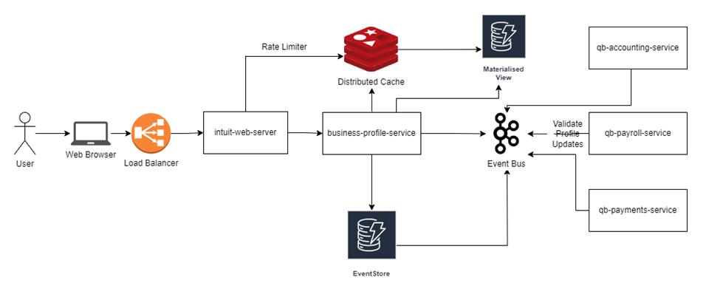
High Level Design

Slide 6
Components
Load Balancer: In a high load distributed environment, the Load balancer will ensure that the requests are highly available. It will help to efficiently distribute incoming web traffic across multiple instances of Web Servers.
intuit-web-server: Serve as the entry point for client requests, handle authentication, authorization, rate limiting, and route requests to the Business Profile Microservice and other downstream services.
business-profile-service: Provide isolated business profile operations and serve data from the underlying data storage systems. It handles requests related to creation, update, and retrieval of business profiles.
Redis Cache: In-memory data structure store, used as a cache. It stores the business profile data that is frequently accessed. The business-profile-service fetches data from Redis for faster retrieval and puts data into Redis after fetching from or updating the DynamoDB materialized view table.
DynamoDB (Materialized View): Store the latest state of business profiles for quick CRUD operations.
DynamoDB (Event Log Table): Captures and stores the event logs pertaining to business profile changes. Any new event in this table is transmitted to the event bus and eventually reflects on the materialized view after approved validation.
Kafka (Event Bus): Serve as the central event bus for asynchronous messaging and event-driven architecture component.

Slide 7
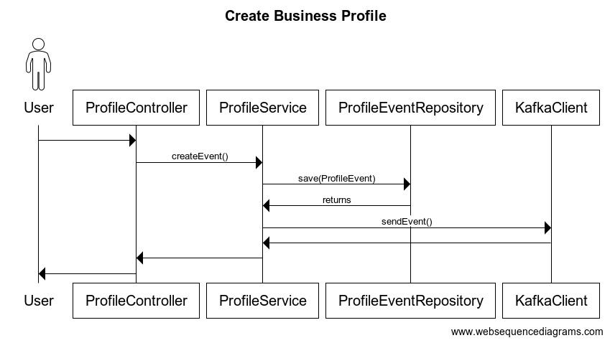
Create / Update Business Profile

Slide 8
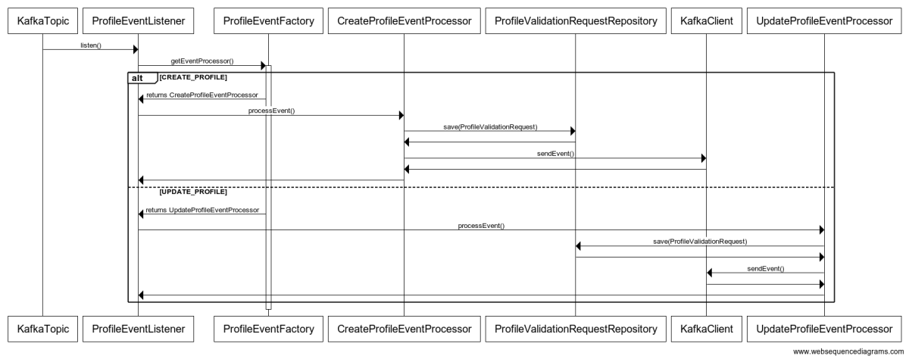

Slide 9
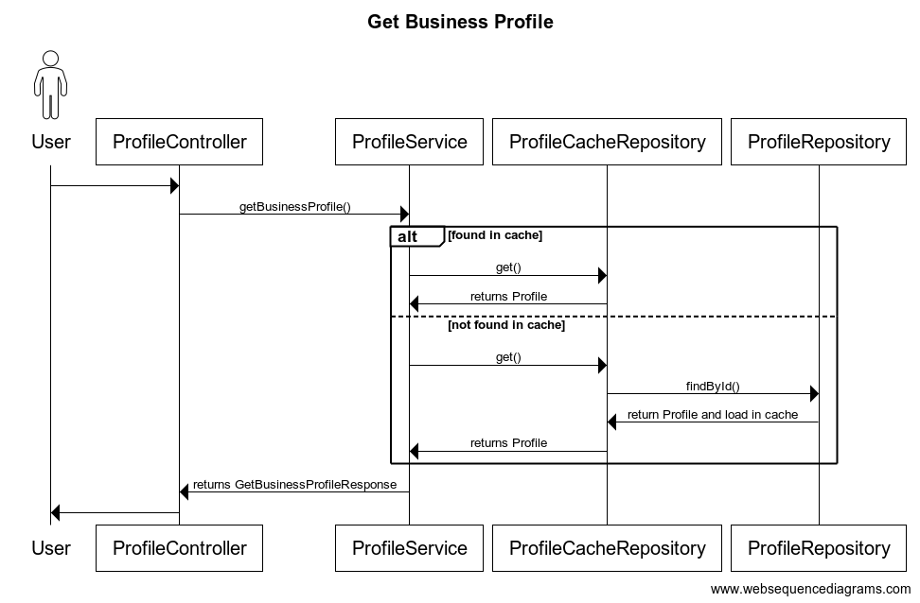
GET Business profile

Slide 10
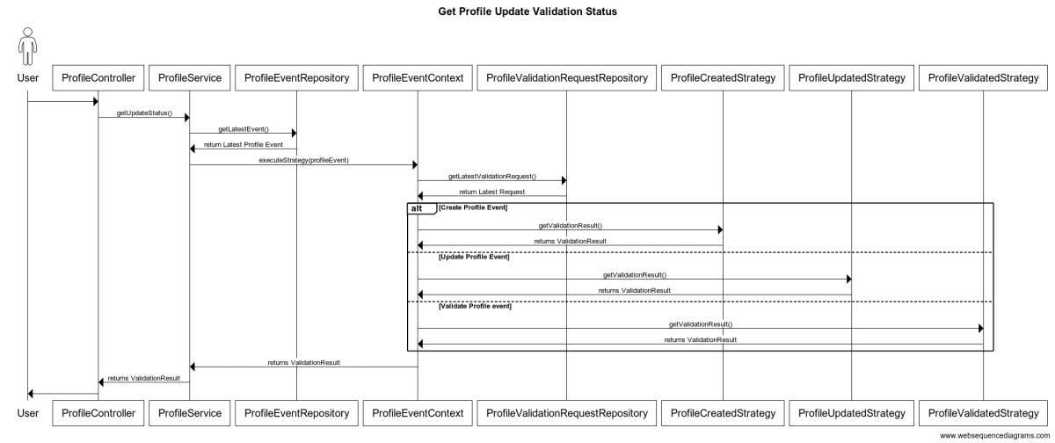
Get profile update status

Slide 11
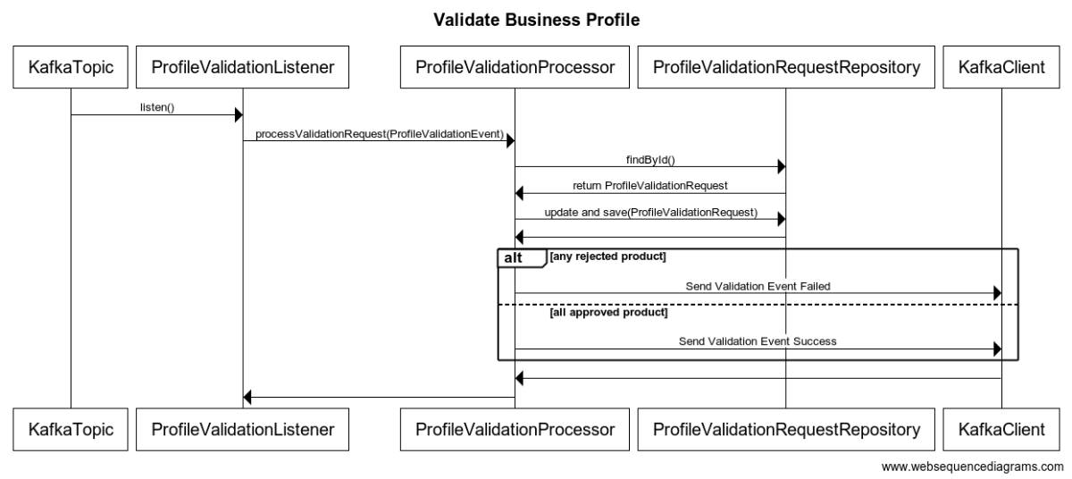
Validate business profile

Slide 12
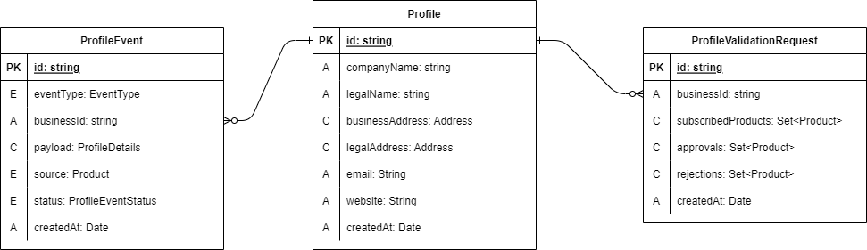
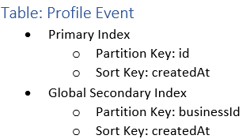
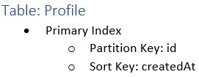
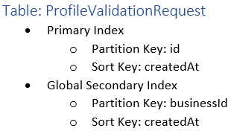
Data store and Model

Slide 13
Launch Plan
Containerization: Use Kubernetes to manage containerized applications, ensuring that they are scalable and highly available.
Internationalization: Deploy the application in different AWS regions closer to the target audience to reduce latency.
Testing: Apart from the unit tests, focus on integration tests, load testing, stress testing, to ensure the application's robustness in production scenarios.
Monitoring: Setup proper monitoring and alarms based on key metrics thresholds on JVM/environment metrics, latency or availability metrics, and business metrics

